Slide 1
Plans for the European contribution to OceanSITES.
FixO³
Richard Lampitt
National Oceanography Centre
Southampton
UK

Slide 2
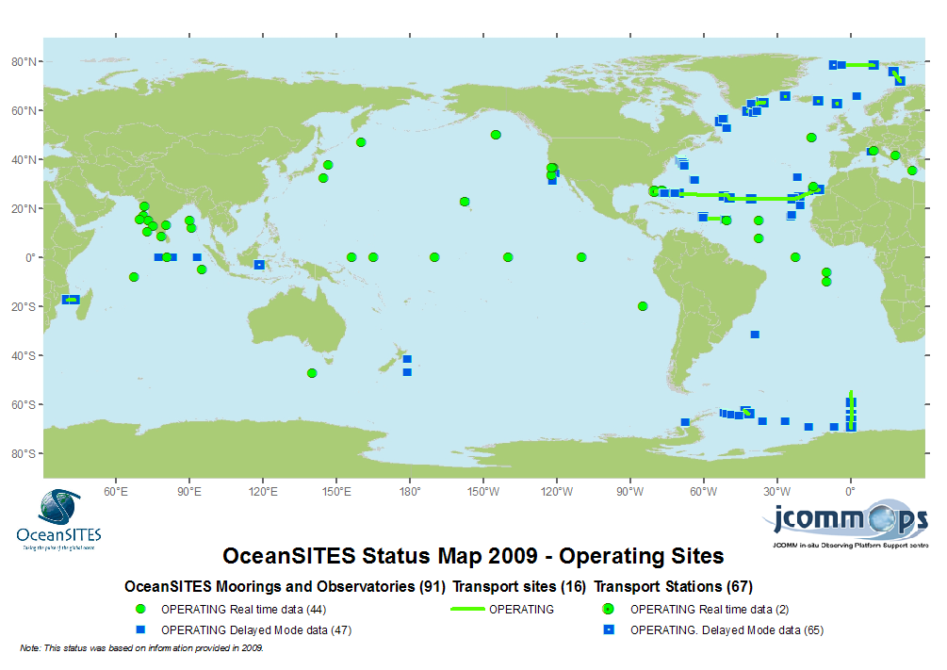
OceanSITES: Global network.
EuroSITES
Notes:
EuroSITES forms the European component of the OceanSITES network of deep ocean observatories: www.oceansites.org. European Impact: EuroSITES is working with relevant European projects to contribute to the sub-sea component of GMES (MCS)

Slide 3
FixO³
Fixed-point Open Ocean Observatory network

Slide 4
The I3 instrument
Integrating Infrastructure Initiative

Slide 5
Function of funding:
1: Observatory support
Staff
Consumables (no equipment)
Research to improve capability
Leverage of national funding
2: Glue
Efficiency of operation
Training & Outreach
Links to industry
Links to governance and policy
3: Access
Provide access to other groups
Notes:
5

Slide 6
Open Ocean
Multidisciplinary
Existing at fixed locations
Building on EuroSITES, ESONET & CARBOOCEAN
Leading to ESFRI
Data standards
Criteria for FixO³

Slide 7
Data:
Freely available to all immediately after collection and QC
Associated metadata
Using internationally agreed protocols and formats
Creditation
Autonomous and “interventive” data

Slide 8
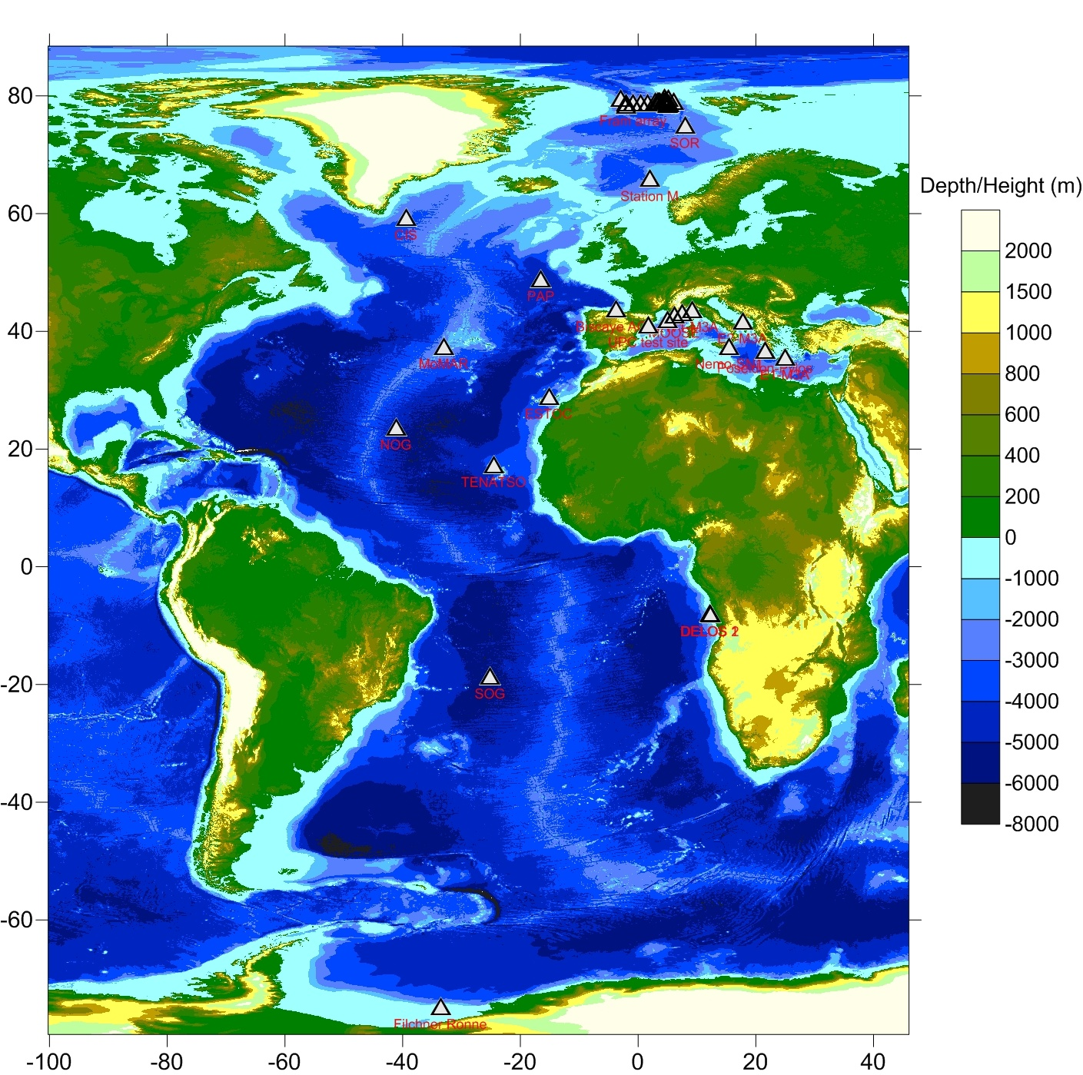
FixO³

Slide 9
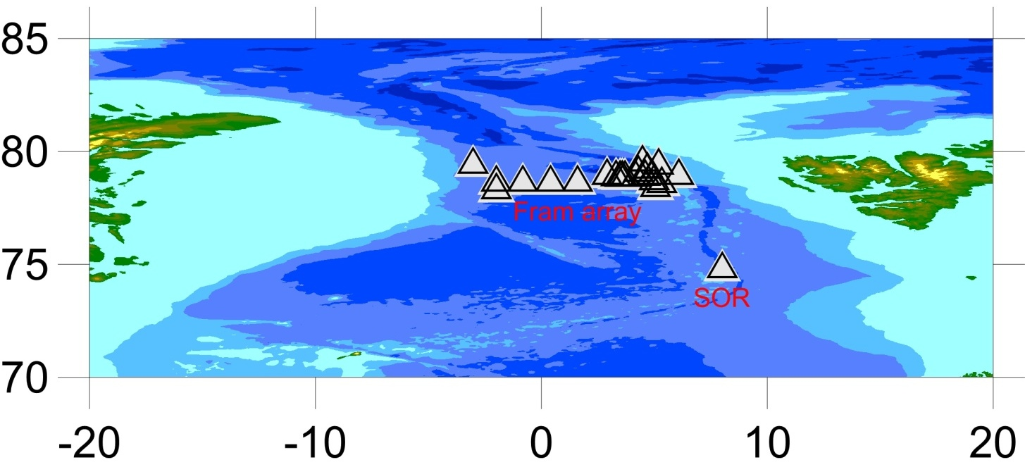
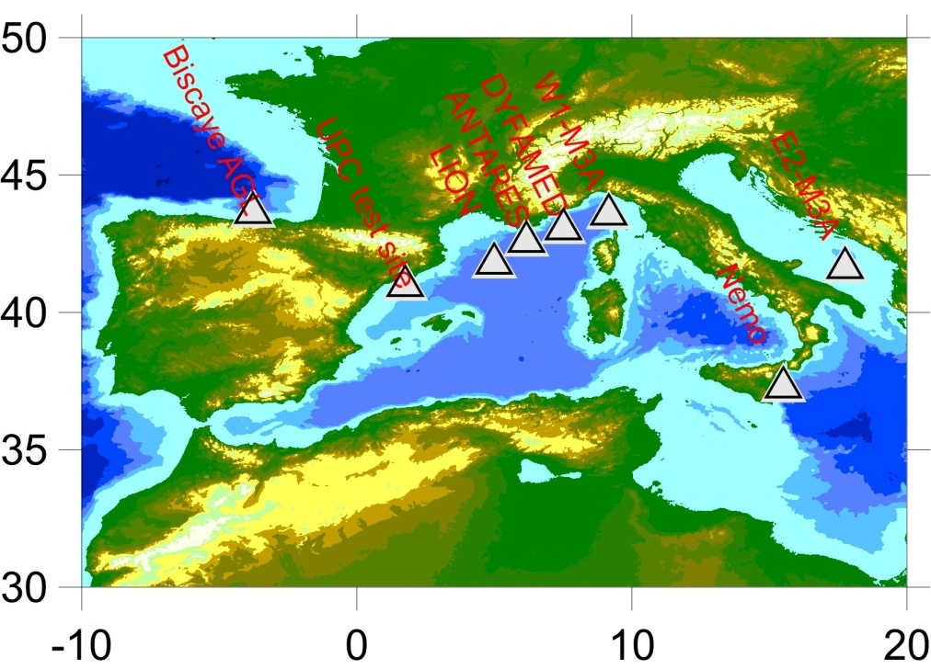
Across the
Fram strait
Within the Mediterranean

Slide 10
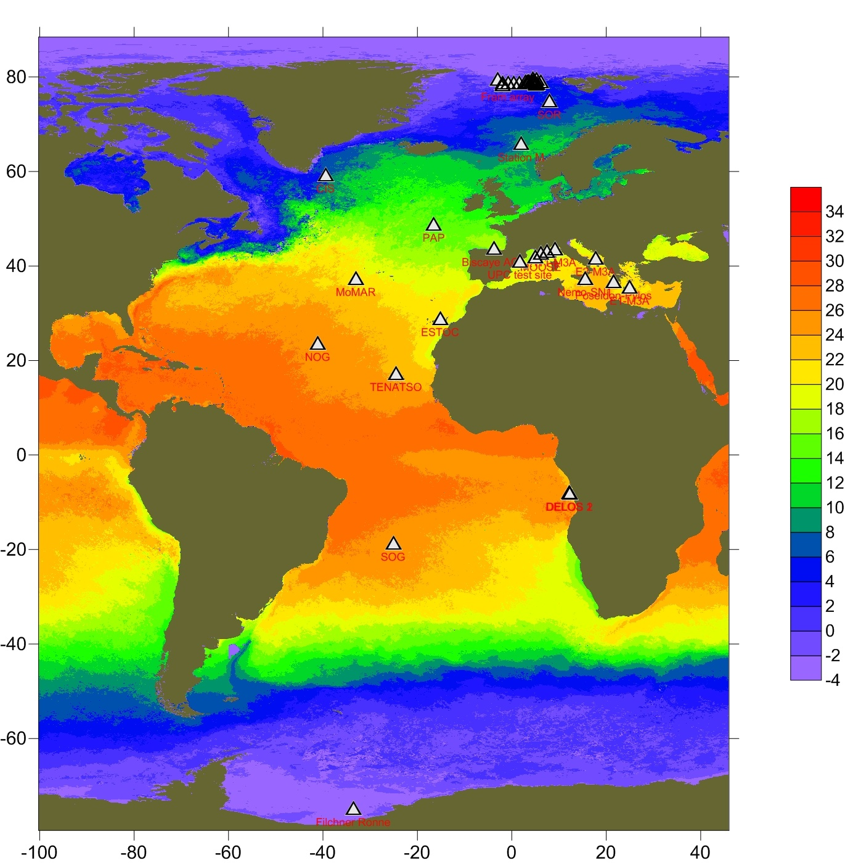
FixO³
With Surface temperature climatology
Courtesy NEODAAS, UK

Slide 11
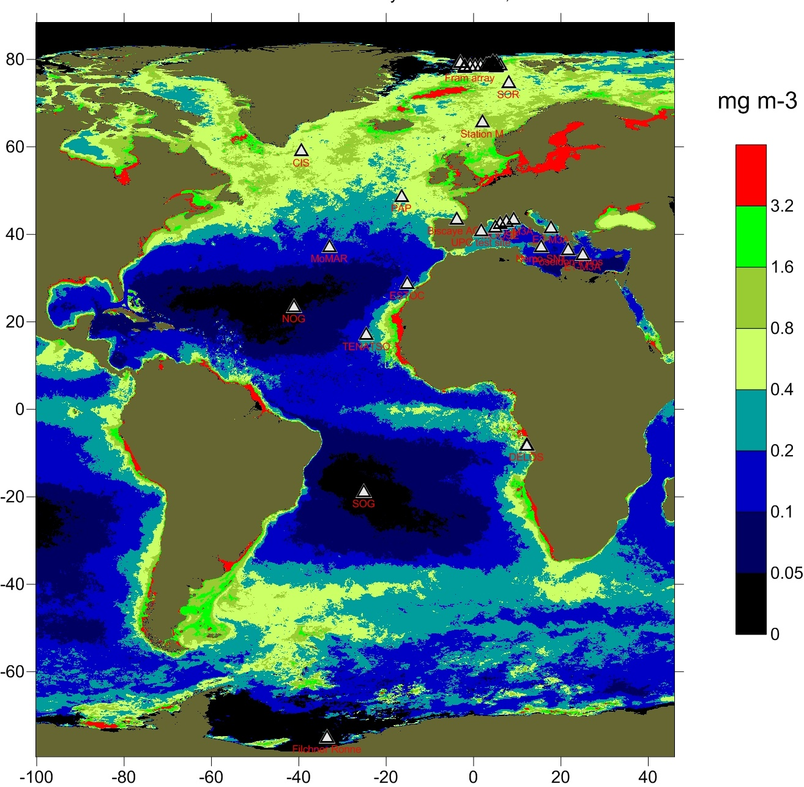
FixO³
With surface chlorophyll (average 2007)
Courtesy NEODAAS, UK

Slide 12
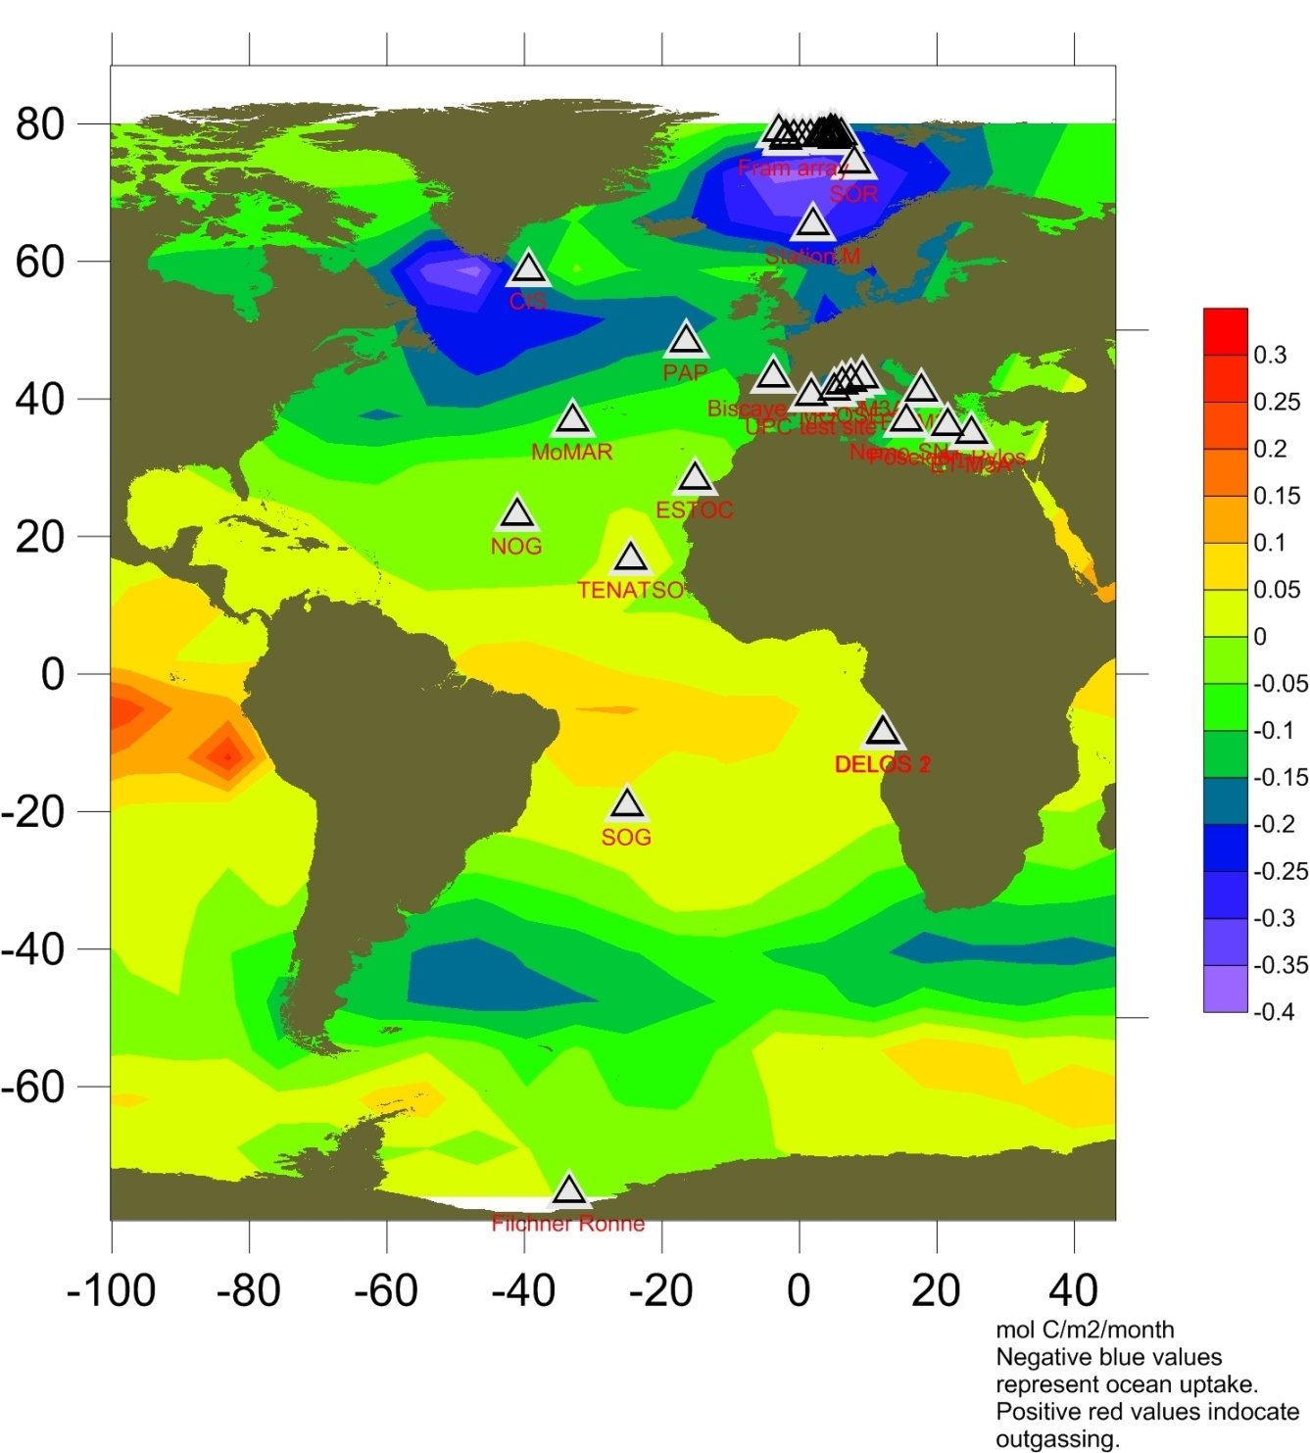
FixO³
With air-sea flux of CO2
(average 2000)
(From Takahashi et al 2009)
Courtesy Ute Schuster, UEA

Slide 13
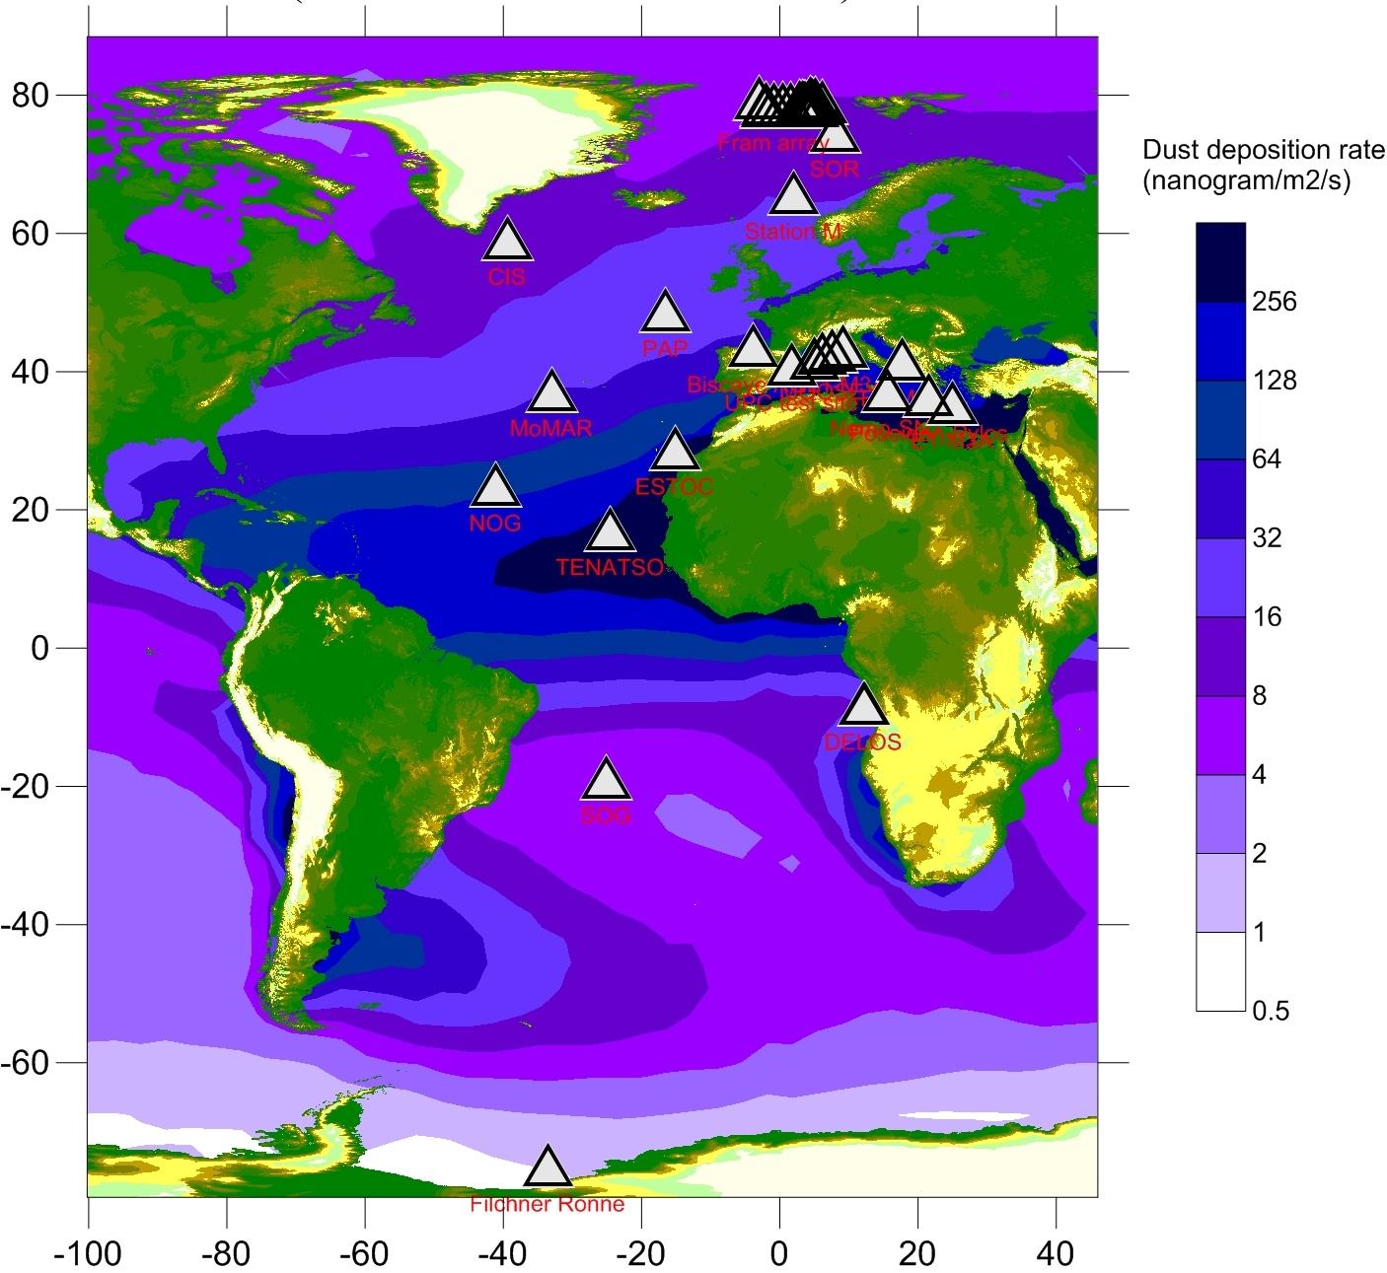
FixO³
With dust deposition rate annual climatology
(from Mahowald 2005)
Courtesy Natalie Mahowald

Slide 14
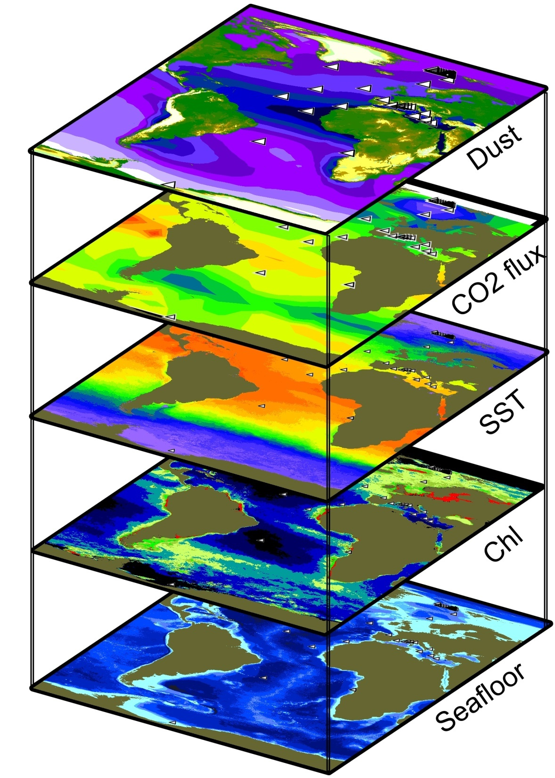

Slide 15
Submission: November 23rd 2011
EU Contribution: 9.7M Euro
29 partner institutions
International advisory board
Coordinated: NOC, UK
Anticipated start: October 2012

Slide 17
FixO³ Workpackages
1: Project management
2: Technological harmonisation
3: Procedural harmonisation
4: Data management and harmonisation
5: Innovation through industry
6: Interface with policy and intergovernmental bodies
7: International and European networking of fixed point observatories
8: Outreach and training
9: Transnational access to open ocean observatories
10: Service activities: Access to data products and knowledge
11: Optimisation of ocean observing capability
12: Research and development on critical observatory functions

Slide 18
A project under this topic should integrate and improve access to the key infrastructures in Europe which make sustained time series observations in the open seas and ocean at fixed critical locations. These infrastructures should support fully multidisciplinary research on the entire oceanic environment, from sea floor to the air-sea interface, including carbon fluxes. The project should build on the investments and expertise developed by EuroSITES, ESONET and CARBOOCEAN projects and could consider expanding geographic coverage. It should also link to planned ESFRI infrastructures, such as EMSO and ICOS, as well as to other relevant initiatives. Data management should be addressed by ensuring compliance with SeaDataNet standards and contribution to the GMES initiative. Links with international initiatives including compliance with GEOSS principles and requirements (data sharing, compatibility) should also be reinforced. Particular attention should be paid to the involvement of European SMEs for the application of innovative technologies for in situ measurements and scientific services (this will be assessed under "Impact" criterion).

